Slide 1
Software Engineering
Fast-National University of computer & Emerging Sciences Fall 2025
Miss Juhinah Batool /Sir Faraz

Slide 2
Today’s Content
Statement Coverage, Branch Coverage
Cyclomatic Complexity and Basis Path Coverage

Slide 3
Statement Coverage
It is one type of white box testing technique that ensures that all the statements of the source code are executed at least once. It covers all the paths, lines, and statements of a source code. It is used to design test box cases where it will find out the total number of executed statements out of the total statements present in the code.
Formula:
Statement coverage = (Number of executed statements / Total number of statements in source code) * 100

Slide 4
int addNDivide(int x, int y) {
int a = 0
if x > y
a=10
return ( (x+y) / a );
}
Write minimum Test Case(s) to achieve 100% Statement Coverage
Input x y z
TC1 _ _ _
Activity: Achieve 100% statement Coverage with minimum test cases

Slide 5
int addNDivide(int x, int y) {
int a = 0
if x > y
a=10
return ( (x+y) / a );
}
Write minimum Test Case(s) to achieve 100% Statement Coverage
x y Output
TC1 26 17 4
Activity: Achieve 100% statement Coverage with minimum test cases

Slide 6
int addNDivide(int x, int y) {
int a = 0
if x > y
a=10
return ( (x+y) / a );
}
Write minimum Test Case(s) to achieve 100% Statement Coverage
x y Output
TC1 26 17 4
Without considering the requirements is there any issue in code? Which other test case could have found it?
Limitation of Statement Coverage

Slide 7
int addNDivide(int x, int y) {
int a = 0
if x > y
a=10
return ( (x+y) / a );
}
Write minimum Test Case(s) to achieve 100% Statement Coverage
x y Output
TC1 26 17 4
1,2
No New Statement Covered but should be tested
3
4
5,6
Without considering the requirements is there any issue in code? Which other test case could have found it?
If y > x then it will result in division by 0 causing system to crash
If we tested x = 16 and y = 32 then we would have found this issue
Limitation of Statement Coverage

Slide 8
Branch / Decision Coverage
Branch coverage in unit testing is a metric that measures the percentage of branches (decision points) in the source code that have been executed during the testing process.
It indicates how well the test cases navigate through different possible outcomes of conditional statements, helping evaluate the thoroughness of testing.
A high branch coverage means that most decision paths in the code have been tested, increasing the likelihood of detecting potential defects.
Formula for Branch Coverage:
Branch Coverage = ((Number of Executed Branches) ÷ (Total Number of Branches)) ✕ 100%

Slide 9
Exercise: Draw Control Flow and Write Unit Tests to achieve 100% Branch Coverage
//function to calculate g.c.d
void gcd(int a,int b)
{
int m,n;
m=a;
n=b;
while(m!=n)
{
if(m>n)
m=m-n;
else
n=n-m;
}
cout<<"\nH.C.F of [ "<<a<<" ] and [ "<<b<<" ] is :: "<<m<<"\n";
}

Slide 10
Exercise: Draw Control Flow and Write Unit Tests to achieve 100% Branch Coverage
#include <iostream>
using namespace std;
int main () {
// local variable declaration:
int a = 100;
int b = 200;
// check the boolean condition
if( a == 100 ) {
// if condition is true then check the following
if( b == 200 ) {
// if condition is true then print the following
cout << "Value of a is 100 and b is 200" << endl;
}
}
cout << "Exact value of a is : " << a << endl;
cout << "Exact value of b is : " << b << endl;
return 0;
}

Slide 11
int someFunc(int x, int y) {
if (x == 0 || y > 0)
y = y / x;
return y;
}
Write minimum Test Case(s) to achieve 100% Statement Coverage
x y Output
TC1 4 4 4
TC2 4 0 4
Statement Coverage = 100%
Branch Coverage = 100%
Without considering the requirements is there any issue in code? Which other test case could have found it?
Limitation of Branch Coverage

Slide 12
int someFunc(int x, int y) {
if (x == 0 || y > 0)
y = y / x;
return y;
}
Write minimum Test Case(s) to achieve 100% Statement Coverage
x y Output
TC1 4 4 1
TC2 6 0 0
Statement Coverage = 100%
Branch Coverage = 100%
Without considering the requirements is there any issue in code? Which other test case could have found it?
If x == 0 then system will result in division by 0. We need a test case like x=0 and y = 12 i.e. need to cover
True and false case of atomic condition x == 0
True and false case of atomic condition y > 0
Limitation of Branch Coverage

Slide 13
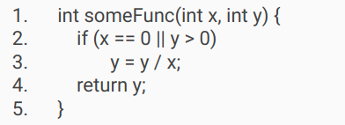
Condition Coverage
The percentage of atomic conditions within decision expressions that have been evaluated to both true and false
Note that 100% condition coverage does not guarantee 100% decision coverage
For example: in previous example, following two test cases will result in 100% Condition coverage but not decision coverage
TC1: x = 0, y = -6
TC2: x = 3, y = 6
2
TC1, TC2
3
4
Notes:
https://csrc.nist.gov/glossary/term/condition_coverage#:~:text=Definitions%3A,not%20guarantee%20100%25%20decision%20coverage.

Slide 14
Decision Condition Coverage
The percentage of all condition outcomes and decision outcomes that have been exercised by a test suite. 100% decision condition coverage implies both 100% condition coverage and 100% decision coverage.
For example: in previous example, following two test cases will result in 100% Condition coverage and 100 % decision coverage
TC1: x = 0, y = 6
TC2: x = 3, y = -6
2
TC2
3
TC1
4

Slide 15
Multiple Condition Coverage
The coverage of all possible combinations of all single condition outcomes within one statement.
For example: in previous example, following four test cases will test all combinations
TC1: x = 0, y = 6
TC2: x = 0, y = -6
TC3: x = 3, y = 6
TC4: x = 3, y = -6
2
TC4
3
TC1, TC2, TC3
4

Slide 16
Loop Coverages
Focuses on the validity of Loop constructs
Simple Loops
Concatenated Loops
Nested Loops
Following Tests case be applied to Loops
Skip the Loop Entirely
Only one pass through the loop
Multiple passes through the loop

Slide 17
Basis Path Testing
A white-box test design technique in which test cases are designed to execute paths.
In path testing Rather than concentrating merely on control flows, path testing is going to try to identify interesting paths through the code that we may want to test.
General Rules
Many simple paths are better that fewer complicated paths.
There is no conceptual problem executing the same code more than once.

Slide 18
Basis Path Testing
Steps towards writing test cases using Basis Path
Draw a control flow graph for Basis Path
Determine Cyclomatic Complexity
Determine basis set of linearly independent Paths
Guidelines mentioned in next slide
Prepare test cases that will force execution of each path in the basis set
Run the test cases and check their results

Slide 19
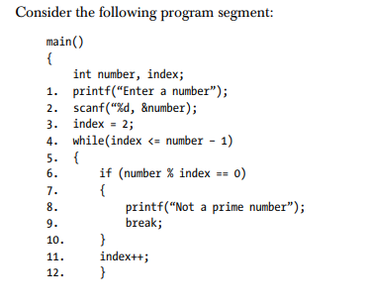

Basis Path Testing
Identify test cases using Basis Path testing

Slide 20
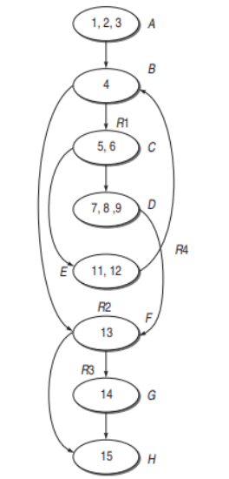
Identify Paths

Slide 21
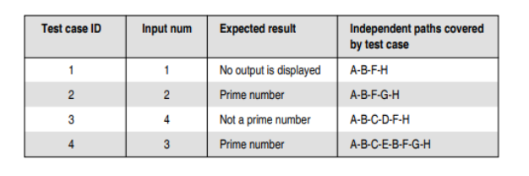
Basis Path Testing
Identify test cases using Basis Path testing
Cyclomatic Complexity = 4
Basis Path
A-B-F-H
A-B-F-G-H
A-B-C-D-F-H
A-B-C-E-B-F-G-H

Slide 22
Cyclomatic Complexity
Cyclomatic Complexity in Software Testing is a testing metric used for measuring the complexity of a software program.
It is a quantitative measure of independent paths in the source code of a software program.
Developed by Thomas McCabe (1976), it’s widely used in software engineering to identify risky code.
Three ways to Compute
V(G) = E - N + 2P
E is the number of edges in Control Flow Graph
N is the number of nodes in the control flow graph
V(G) = P + 1
P is the number of predicates nodes in control flow graph
V(G) = Number of In-bound Regions(R) + 1
Notes:
The cyclomatic complexity V(G) is said to be a metric for a program's logical complexity.

Slide 23
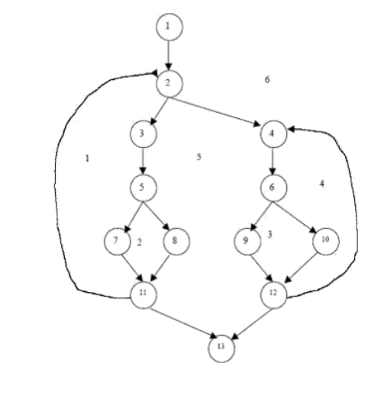
Cyclomatic Complexity
In-bound Region, R = 5
Number of Nodes, N = 13
Number of Edges, E = 17
Number of Predicate Nodes, P = 1
Cyclomatic Complexity =
R + 1 = 5 + 1 = 6
P + 1 = 5 + 1 = 6
E - N + 2 = 17 - 13 + 2 = 6

Slide 24
